Slide 1

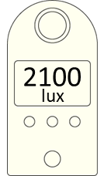
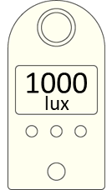
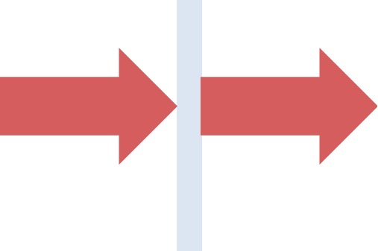

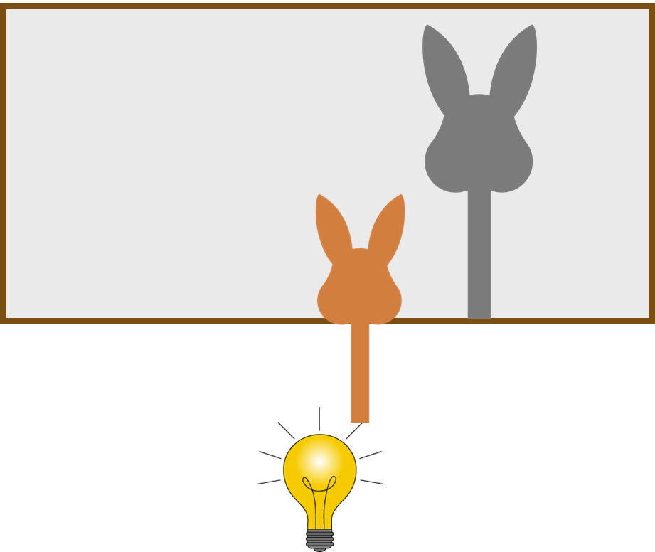
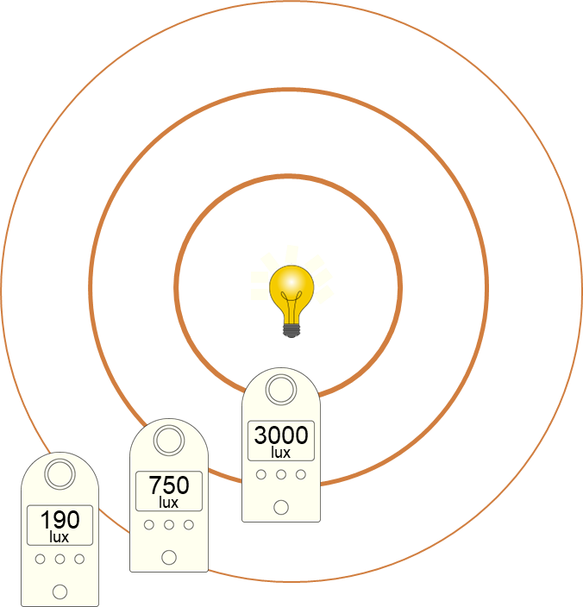
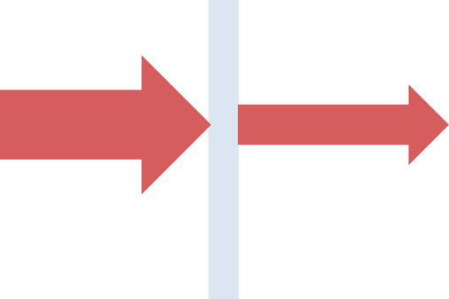
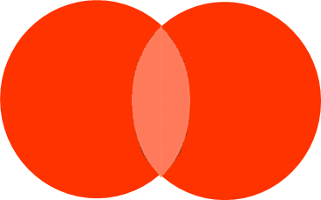
Sound and Light
Describing light
Brightness
Different media
intensity
can be seen
Light is transmitted through any transparent media, including a vacuum.
source
high (bright)
low (dim)
luminous
illuminated
large
small
transparent
make their own light
need light shining on them
amplitude
Some sources transmit more energy away in a given time.
opaque
Light cannot be seen directly as it travels.
emits
Light travels
Light spreads out from a source.
Brightness decreases with distance.
translucent
away from source
from every point
in all directions
very fast
All materials absorb some energy from light.
Opaque objects transmit nothing (forming shadows).
Light meter measures brightness in lux.
Energy pathways
rays
From a source, light travels …
Light from multiple sources falling on a screen is brighter than one.
away by
Light is constantly emitted from a source that is ‘on’.
Light fills an enclosed space.
Darkness is the absence of light.
radiation
to
brighter region of light
detectors
away by
Light is the transfer of energy by the radiation pathway to its surroundings, so that a region is lit up.
electrical
heating
chemical reaction
Science | 7.06: Sound and light | Knowledge Organiser
Notes:
Images:
All images – United Learning

Slide 2
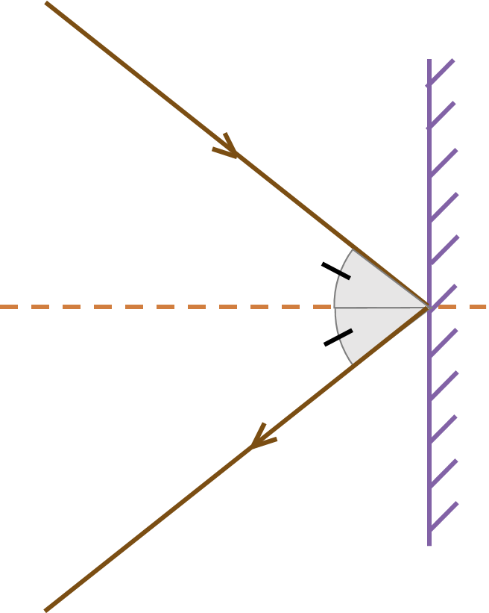
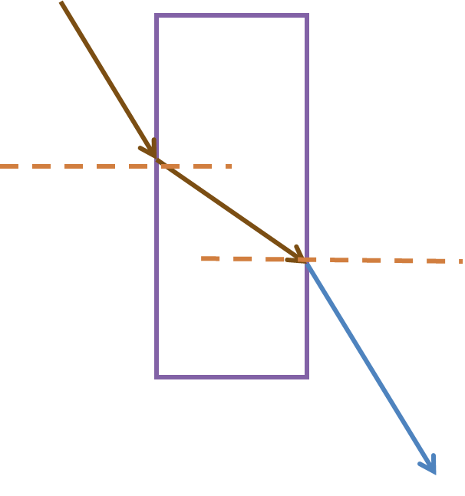
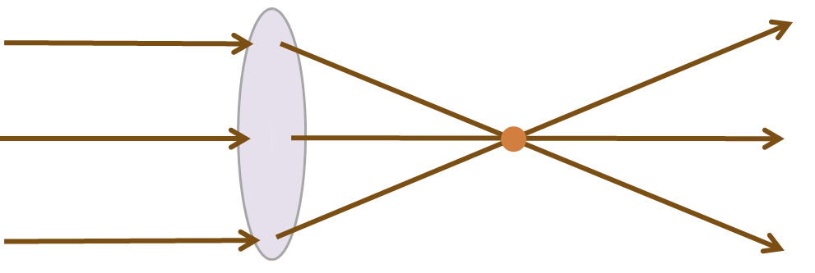
Sound and Light
Light reflecting
incident ray
plane mirror
All surfaces reflect light and obey the law of reflection.
angle of incidence
the angle of incidence
the angle of reflection
normal line
=
angle of reflection
diffuse reflection
specular reflection
reflected ray
Most surfaces reflect light diffusely (scatter it).
Light refracting
As the angle of incidence increases, there is more refraction.
Converging lenses form a focus and can form a clear image.
Lenses
incident ray
incident light parallel to central normal
air
glass
focus
Light slows down on entering more dense media.
It turns towards the normal.
refracted ray
converging lens
normal line
The focal length is the distance from lens to focus, or lens to image.
Thicker lenses (more curved) refract more, have a closer focus and longer focal length.
Light gets faster on entering less dense media.
It turns away from the normal.
emerging ray
Science | 7.06: Sound and light | Knowledge Organiser
Notes:
Images:
All images – United Learning

Slide 3
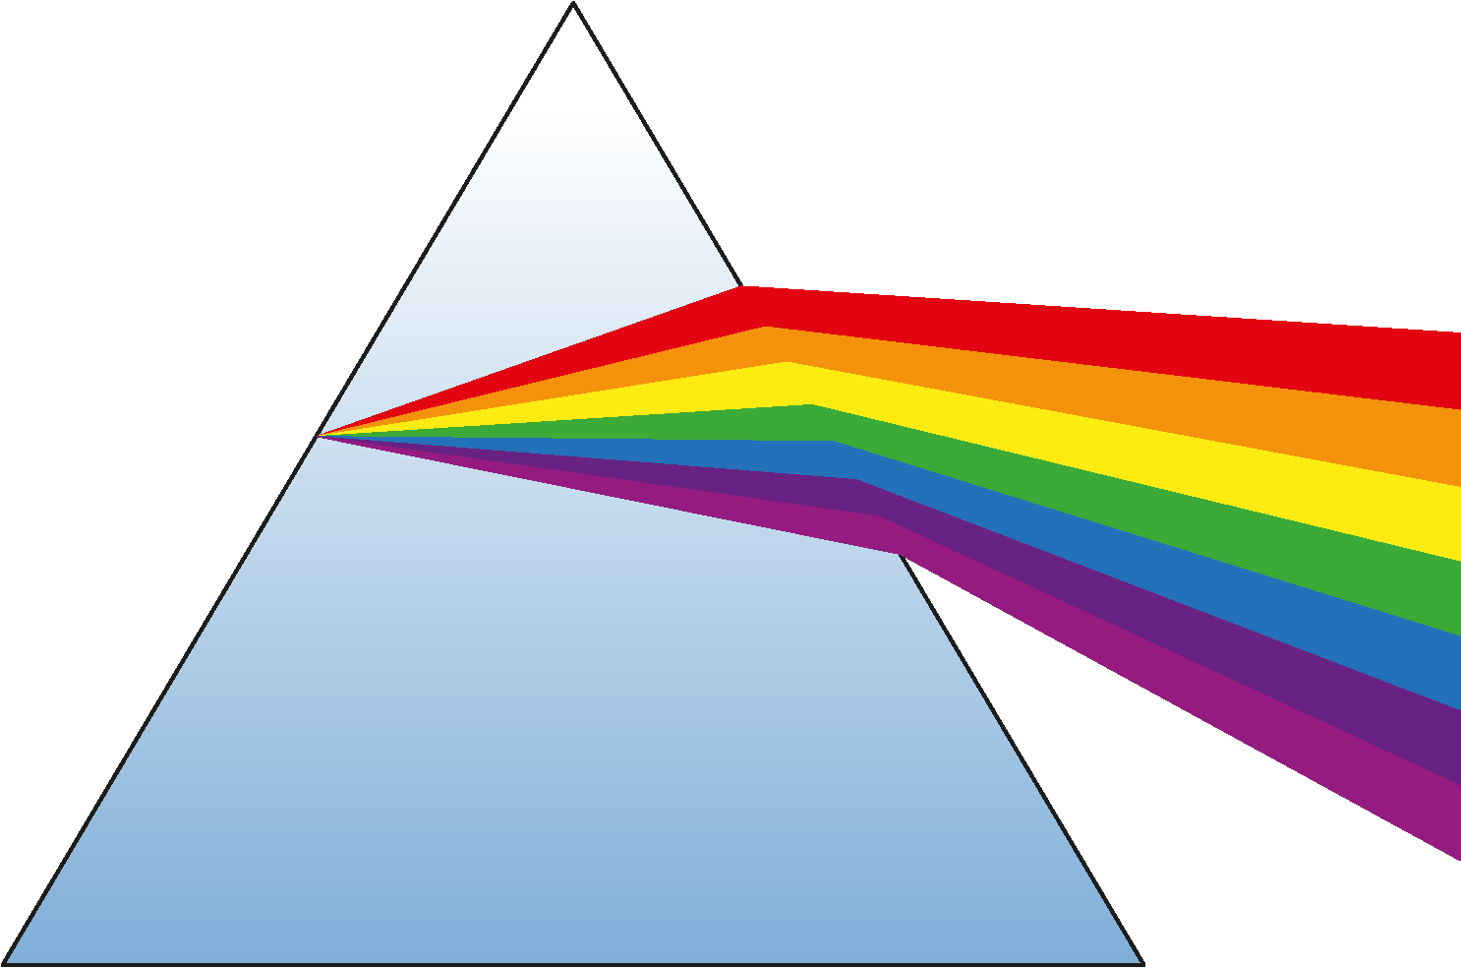
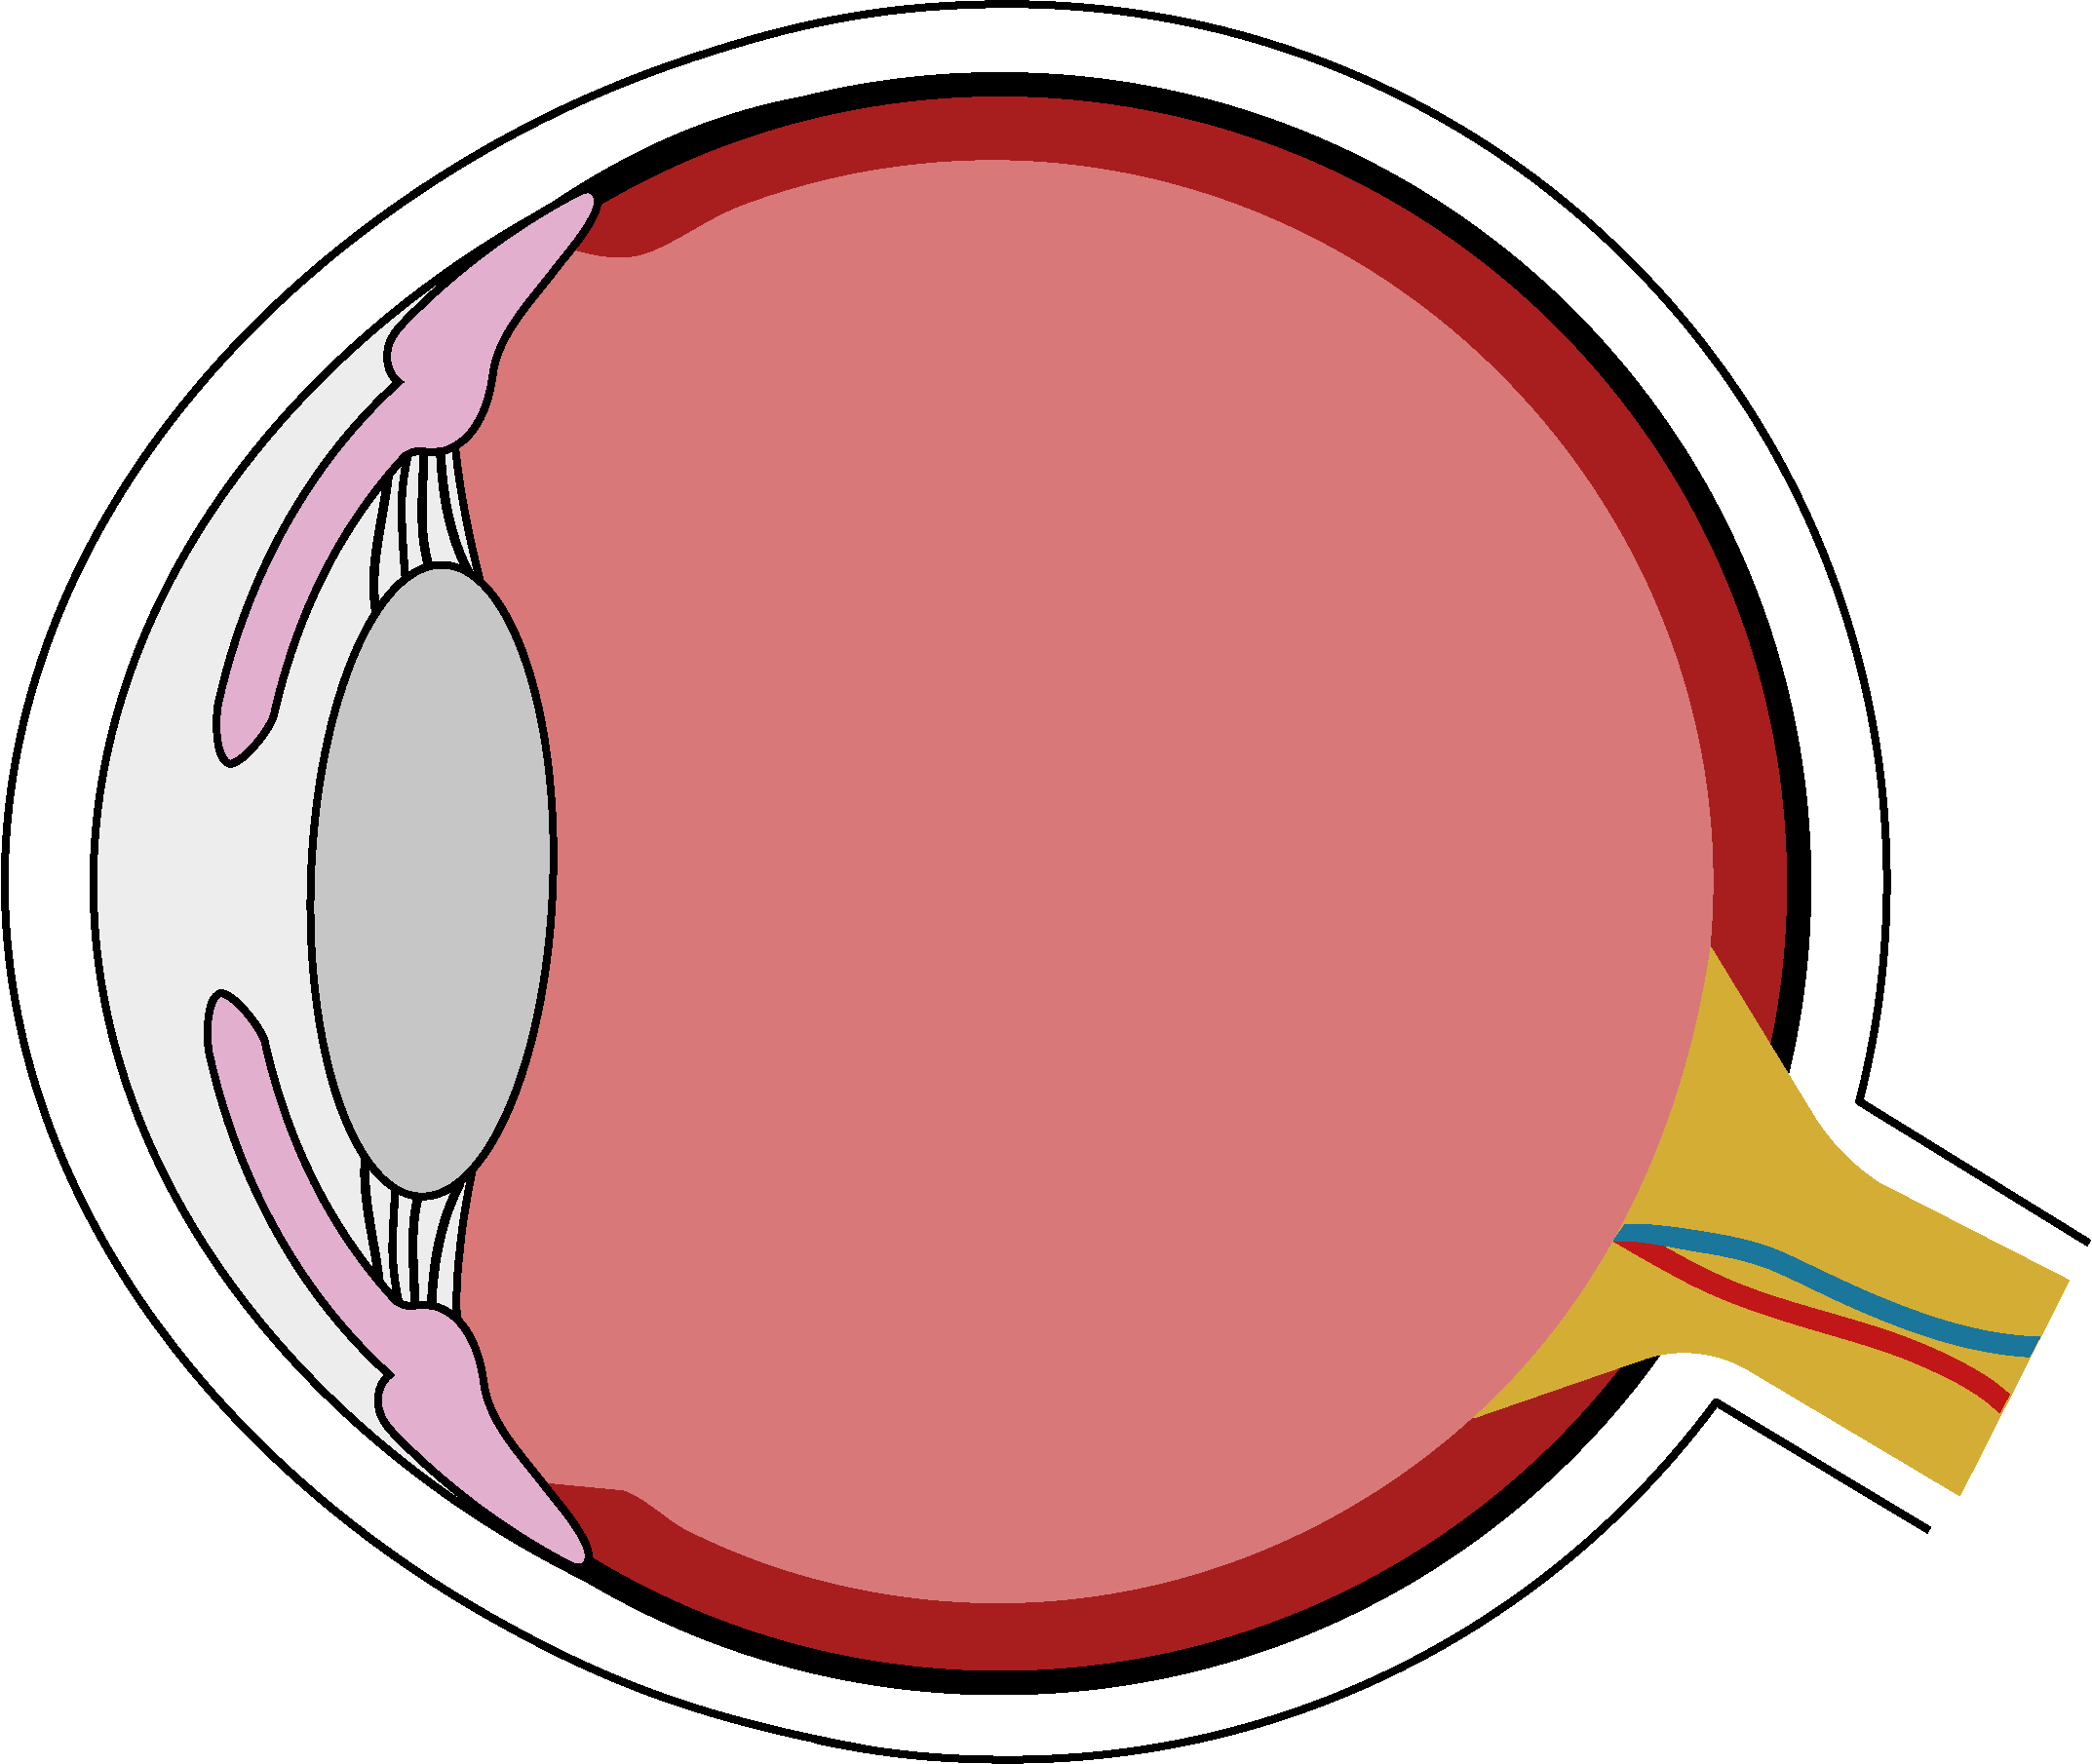
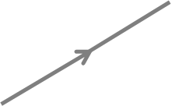
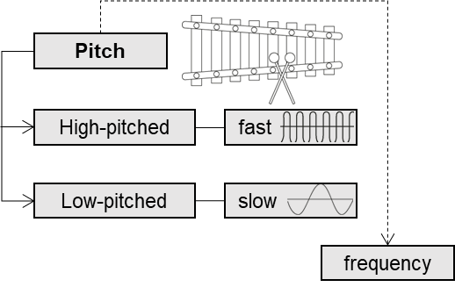

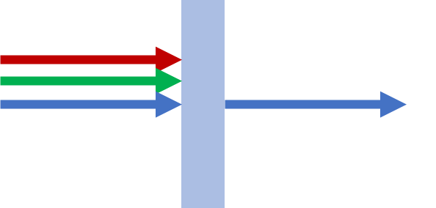
Sound and Light
Coloured light
Luminous objects emit light of particular colours.
Most common sources emit white light.
Seeing differences
Many problems with our vision are caused by parts of the eye that are not the right shape or size, that have become cloudy, or due to cell damage.
visible spectrum
red
orange
yellow
green
blue
indigo
violet
white
light
glass prism
refractive errors
disease or trauma
not preventable but treatable
may be preventable and treatable
colour
violet
red
People with low vision may use:
Long canes, guide dogs, talking books, Braille or other assisted devices.
high
low
frequency
blue filter
Light from the Sun can be dangerous:
Never look directly at the Sun.
Wear sunglasses in bright sunlight.
Protect the skin too.
Coloured filters:
transparent objects
transmit own colour
selectively absorb any other colour of incident light
white light incident
absorption of red and green light
Science | 7.06: Sound and light | Knowledge Organiser
Notes:
Images:
All images – United Learning

Slide 4
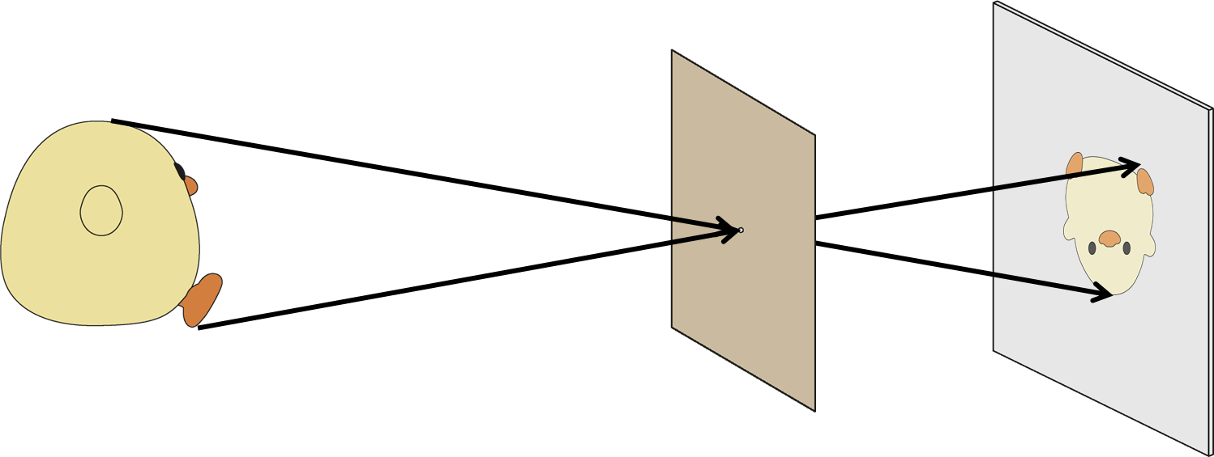
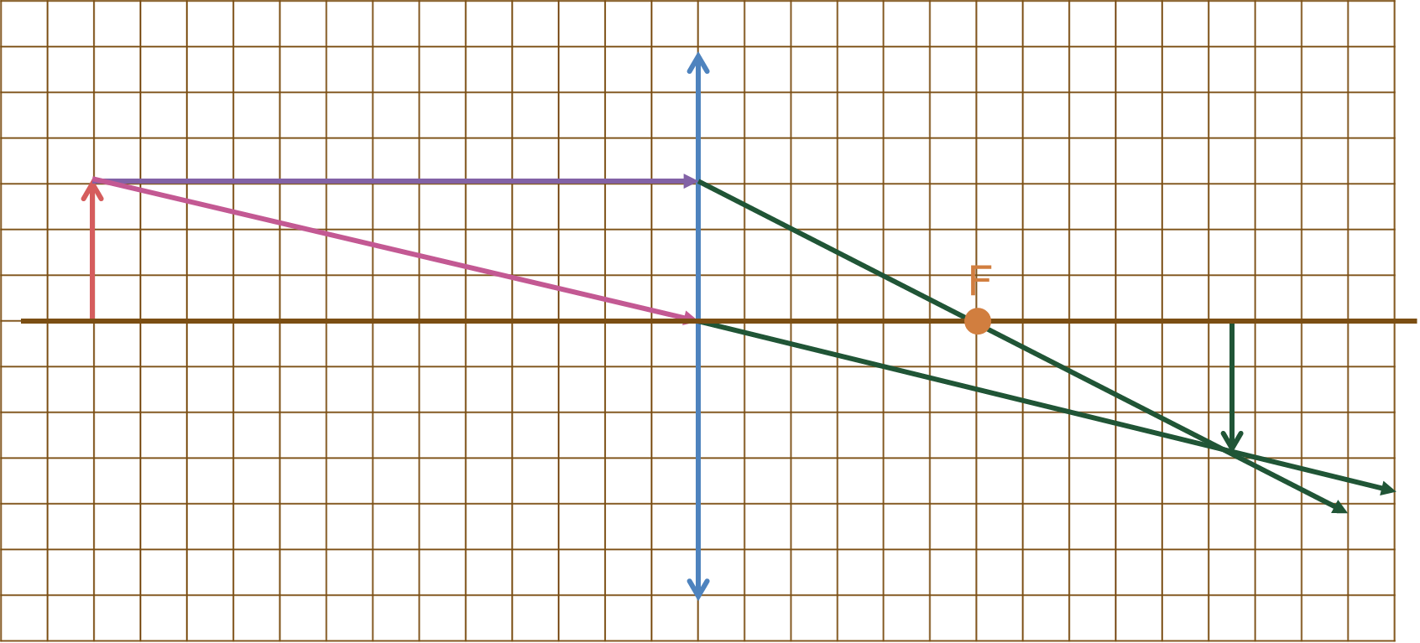
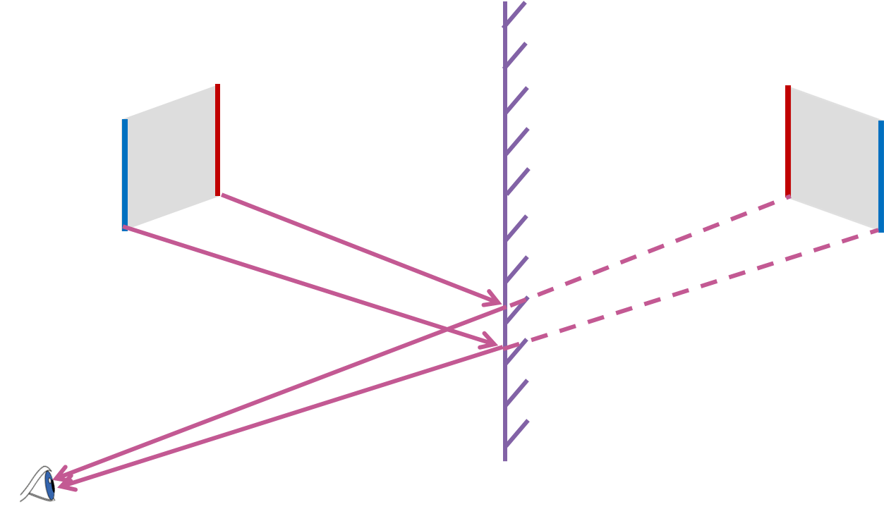
Sound and Light
Images
Images from lenses
Some light from each point refracts through the lens.
Light from each point arrives at specific points on the surface forming an image.
Image is:
inverted
dim
diminished.
Image is:
inverted
dim
diminished.
Pinhole camera
Some light from each point of the object passes through the pinhole.
The pinhole only allows a narrow beam through from each point.
Light from each point crosses over as it passes through the pinhole.
Light from every point falls on the screen forming a complete image.
object
Mirror image
Light from every point of the real object reflects into the eye.
The brain interprets reflected light as originating from behind the mirror.
converging lens
image
A partially covered lens still forms an image, but dimmer.
where object appears to be
real object
right way up
same size
same distance
Science | 7.06: Sound and light | Knowledge Organiser
Notes:
Images:
All images – United Learning

Slide 5
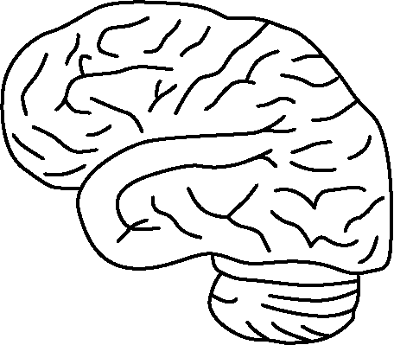
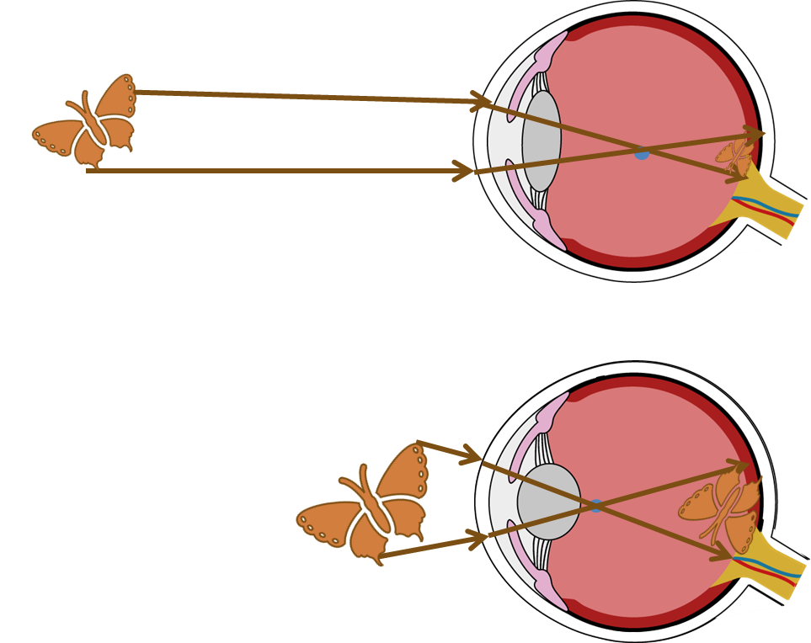





Sound and Light
The human eye
lens
special light- sensitive cells on the retina
cornea | refracts light before it enters the eye
iris | controls the size of the pupil
pupil | lets light enter the eye
lens | refracts light to form an image
retina | made up of cells that detect light
optic nerve | carries electrical signals to the brain
cornea
pupil
iris
optic nerve
Seeing objects
absorbed
Seeing at different distances
processed
reflected
absorbed
thin, flat lens
thicker, round lens
The lens shape changes as needed.
incident light
object
reflected light
eye
brain
Refraction errors of the eye
short-sightedness
long-sightedness
eye too long or the cornea too extended: focus in front of retina
eye too short or the cornea too rounded: focus behind the retina
Seeing coloured objects
If an opaque object is coloured, it has pigments which absorb specific colours.
absorbs any colour not in the pigment
appears the colour of any scattered light
white light incident
red pigment
Glasses to spread out the light before it enters the eye.
Glasses to converge the light before it enters the eye.
absorption of blue and green light
Science | 7.06: Sound and light | Knowledge Organiser
Notes:
Images:
All images – United Learning

Slide 6
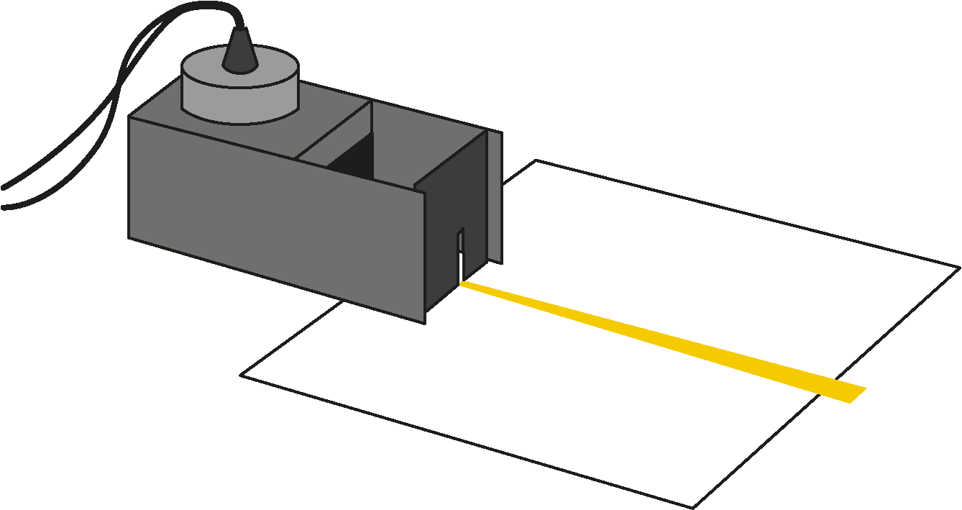
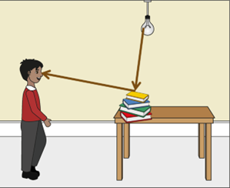
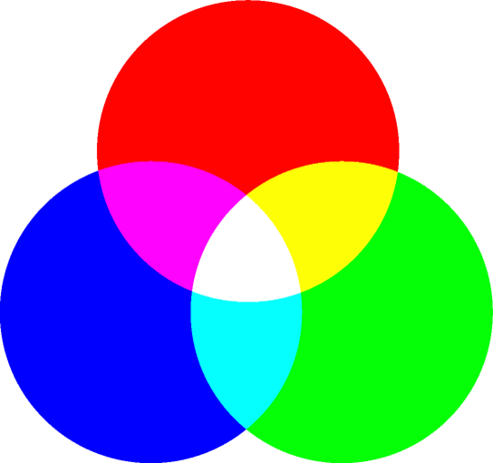
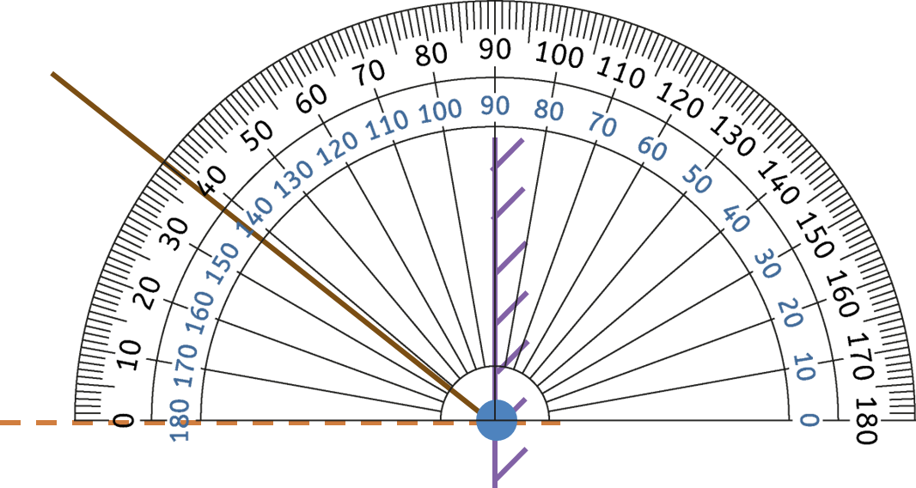

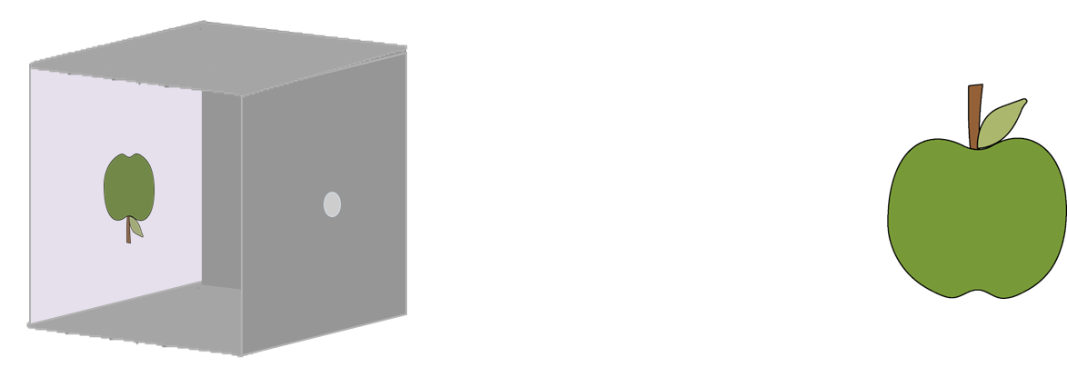

Sound and Light
Scientific models
Representations of reality that can be used to explain observations
Observing light
Using a raybox
The raybox and comb are connected to a power supply.
Draw crosses (avoiding likely measurement errors).
Plot and label rays.
The ray model of light
Rays are imaginary lines, drawn to represent the path light is travelling.
From an infinite number, a few are chosen to be drawn.
The ‘passive-eye’ model of vision
Objects emit or reflect light into the eye.
The ‘three primary colours’ model of human colour vision
The eye has three types of sensor cell.
It detects red, green and blue - the primary colours of light.
When directed at a white screen, combinations of primary colours can appear as secondary colours or white (and more).
The pinhole camera as a model for the eye
Light enters through the pinhole similar to the pupil.
Light ‘crosses over’ at the pinhole, similar to the lens.
Light from the object falls on the screen, similar to the back of the eye.
straight
arrow
Measuring angles
Place the centre at the vertex.
The scale starts at 0° on the normal line.
Read up from 0°.
magenta
yellow
cyan
Trusted scientific research
High-quality data
Well-chosen method
Appropriate resolution
Multiple measurements
Repeatable
Reproducible
Appropriate range
Systematic intervals
Trustworthy conclusions
Process and display collected data
Describe data from table or chart
Explain
interpreted data
Science | 7.06: Sound and light | Knowledge Organiser
Notes:
Images:
All images – United Learning

